Slide 1

GRADUATE ACADEMY
Understanding Big Data
© BJSS Ltd. 2019 Commercial in Confidence

Slide 2

BIG DATA
Big data is data sets that are so voluminous and complex that traditional data-processing application software are inadequate to deal with them.
Big data challenges include capturing data, data storage, data analysis, search, sharing, transfer, visualization, querying, updating, information privacy and data source.

Slide 3

VOLUME
The CERN Data Centre passed a major milestone on 29 June 2017 with more than 200 petabytes of data now archived on tape.
Particles collide in the Large Hadron Collider (LHC) detectors approximately 1 billion times per second, generating about one petabyte of collision data per second.
Even after the drastic data reduction performed by the experiments, the CERN DC processes on average one petabyte of data per day.
Notes:
https://home.cern/news/news/computing/cern-data-centre-passes-200-petabyte-milestone

Slide 4

VELOCITY
With Office 365 data there is much data velocity. It’s very high frequency data with 10 terabytes (TB) stored a day.

Slide 5

VARIETY
Variety in Big Data refers to all the structured and unstructured data that has the possibility of getting generated either by humans or by machines.

Slide 6

VERACITY
Veracity is all about making sure the data is accurate, which requires processes to keep the bad data from accumulating in your systems.

Slide 7

VALUE
The primary reason why Big Data has developed rapidly over the last years is because it provides long-term enterprise value.
Value is captured both, in terms of immediate social or monetary gain, and in the form of a strategic competitive advantage.

Slide 8

DATA STRATEGY
Define and understand problem domain
Data resources positioned effectively
Identify, store, provision, process, govern
Data inventory, protection and architecture
Lives and evolves alongside long term plan
Road-map to unlock value streams

Slide 9

ECOSYSTEM
Data
Ingestion
Storage
Compute
Results
Visualization
Insights

Slide 10

DATA
80% of all modern data is unstructured
90% of the worlds data was created in the last 2 years
Need a strategy to analyze, process and understand unstructured data
Structured | Semi-Structured | Unstructured
Relational Databases | NoSQL Databases | Email
 | CSV | Word Document
 | JSON | Video
 | XML | Web Page
 |  | Audio
 |  | Presentations

Slide 11

SQL
Organize data into
Table (relation)
Column (attribute)
Row (tuple)
Follow Codd’s 12 Rules
Attribute
Tuple
Relation

Slide 12

NOSQL
Document | Column
The central concept is the document. Assume that documents capture or encode all data. Often encoded as XML, JSON or YAML. | Data arranged with data stored in columns. A timestamp is used to differentiate current and stale records. Many columns form a Column Collection.
MongoDB CouchDB RavenDB | Cassandra HBase Accumulo
Graph | Key Value | Object
Uses graph structures and semantic queries. Nodes and edges with properties are used to represent data and relationships. | A data store designed for storing, retrieving and managing associative arrays (hash/dictionary). Records are quickly retrieved via a unique key. | A database management system in which information is represented as objects as used in an object-oriented language.
neo4j JanusGraph Tinkerpop | Redis Riak Oracle NoSQL | db4o ObjectDB JADE

Slide 13

CAP THEOREM
When designing distributed web services, there are three properties that are commonly desired: consistency, availability, and partition tolerance. It is impossible to achieve all three.
PACELC goes further, another trade-off also exists: between latency and consistency, even in absence of partitions, providing a more complete portrayal of consistency tradeoffs for distributed systems.

Slide 14

INGESTION
AirFlow
Sqoop
Flume
Azure Data Factory
AWS Glue

Slide 15

ETL / ELT
Extract-Transform-Load
OLAP/SSIS
Vertical Scale
Specific transforms
Data warehousing
Up-front investment
Extract-Load-Transform
Horizontal Scale
Transform on-demand
Data lakes
Unlimited potential

Slide 16

STORAGE
Hadoop File System (HDFS)
Azure Storage Accounts (WASBS/ABSFS)
AWS S3 Buckets (S3A)
Parquet Columnar Files
Databricks Delta

Slide 17

COMPUTE
Hadoop
Spark
Hive
Flink
Pig
Mahout

Slide 18

BATCH
Value

Slide 19

STREAMING
Real-time / near real-time processing
Rich metadata derived from stream
Time windowed operations
Build and define streaming topology

Slide 20

RESULTS
Value

Slide 21
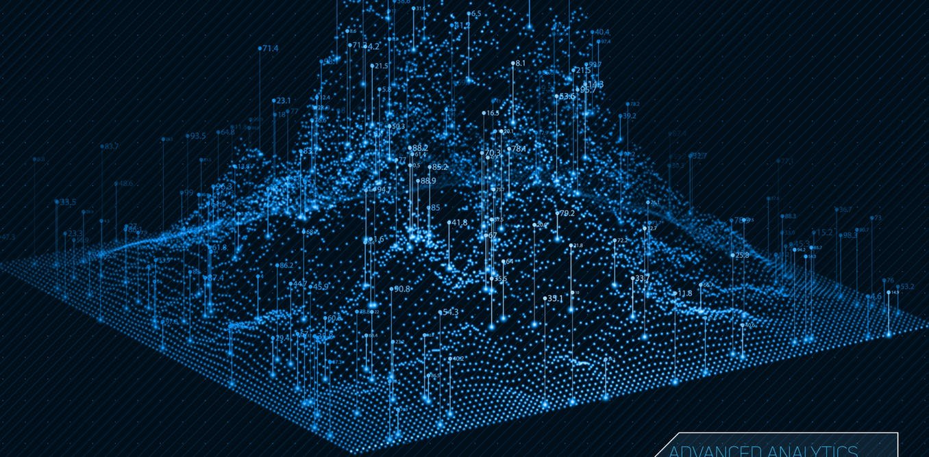
VISUALIZATION
Value

Slide 22

INSIGHTS
Value

Slide 23

PIPELINES
Value

Slide 24

MONETISATION
Value

Slide 25

THE GOOD, THE BAD & THE UGLY OF DATA

Slide 26

POWERING AI
Value

Slide 27















DATA PLATFORM

Slide 28







DATA PLATFORM

Slide 29




DATA PLATFORM

Slide 30
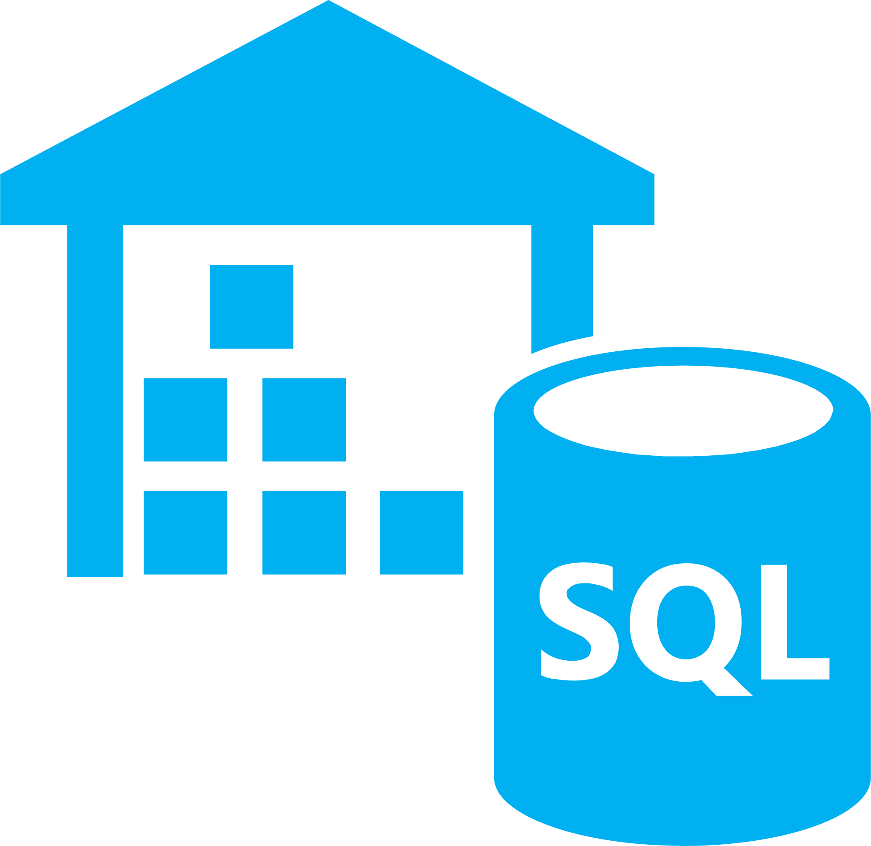



DATA PLATFORM

Slide 31

HANDS ON LAB
Storage
Ingestion
Preparation

Slide 32

HANDS ON LAB
Batch Processing

Slide 33

HANDS ON LAB
Stream Processing

Slide 34

HANDS ON LAB
Deployment
Mobilization
Visualization

Slide 35

REVIEW & QUESTIONS

Slide 36

ORCHESTRATION
Value

Slide 37

ORCHESTRATION
Value

Slide 38

ORCHESTRATION
Value

Slide 39

ORCHESTRATION
Value

Slide 40

ORCHESTRATION
Value

Slide 41

ORCHESTRATION
Value

